Slide 1

GOLD PRICE
PREDICTION MODEL
By
ESHAN MODH (21051991)
ABIR SARKAR (2105090)

Slide 2

CONTENT
01
02
INTRODUCTION
LITERATURE REVIEW
03
04
PROBLEM STATEMENT
METHODOLOGY
05
06
RESULT ANALYSIS
CONCLUSION

Slide 3

INTRODUCTION
“Our project addresses the challenge of predicting gold prices, crucial for navigating market volatility. Leveraging machine learning, we utilize a meticulously curated decade-long dataset encompassing gold prices, economic indicators, and market trends. Our sophisticated approach involves harnessing regression algorithms to develop a robust model capable of predicting future gold prices with enhanced precision.”

Slide 4
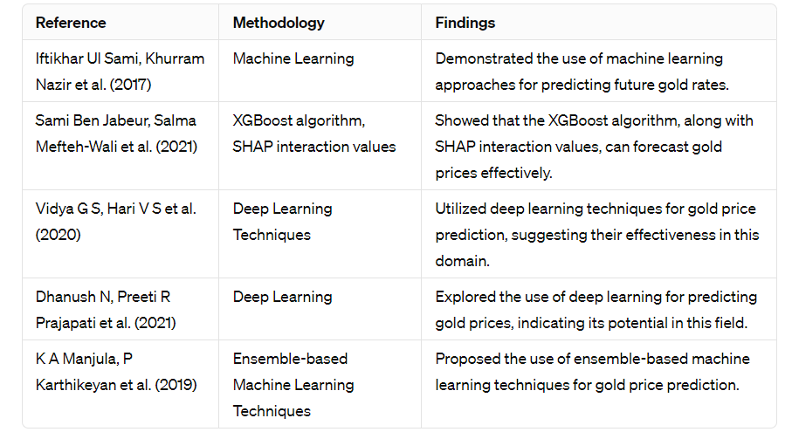
LITERATURE REVIEW

Slide 5
PROBLEM STATEMENT
Predicting gold prices accurately is a a complex task due to highly complex relationships among financial factors of market. This project aims to enhance prediction accuracy by leveraging advanced machine learning algorithms, including Linear, SVM, XGboost, Random Forest, AdaBoost, and Gradient Boosting, in addition to traditional linear regression and support vector regression methods. By training on a decade of historical data, the model aims to offer more precise forecasts.

Slide 6

METHODOLOGY
1
2
3
4
DATA COLLECTION
AND PROCESSING
FEATURE
EXTRACTION
MODEL TRAINING
AND EVALUTION
DEPLOYMENT AND
MAINTAINENCE
Prepare the collected data for machine learning model training by cleaning, formatting, and transforming it into a suitable format.
Training a machine learning model involves fitting an algorithm to a training dataset, enabling it to learn the underlying patterns and relationships within the data
Take the preprocessed data and extract the most important features. This could entail finding the attributes connected to the sales and choosing the features that have the strongest association with the desired variable.
The graphical user interface (GUI) application's deployment marks a crucial project milestone that necessitates thorough testing to make sure it complies with project criteria.

Slide 7
DATASET DETAILS
The dataset which we have used for our project is daily price of gold per 10 gm in indian rupees. Dataset is then preprocessed before sending it for model training. checking for any discrepancy is done. if any unwanted entry is found it is would be filled with appropriate correct values.
the dataset is further standardized and normalized to avoid any kind of outliers, which could potentially adversely effect the model predictions and decrease the accuracy of the model.

Slide 8
MODEL TRAINING
In this project we have used various regression models like Linear regression, XGBoost Regression, ADABoost Regression, Support Vector Regression and Gradient Regression.
They are trained using fit() method (X_train and Y_train). Subsequently they trained models are evaluated using (X_test and Y_test).
Finally the trained models are saved as pickle files for future use, facilitating easy deployment and prediction of new data

Slide 9
MODEL DEVELOPMENT AND TESTING
Model will be trained on preprocessed data. throughout process we would continuously monitor using performance metrics like R-square, MSE and MAE to identify model’s effectiveness.
Once Training is completed, model will be test against test dataset to validate model’s performance.this process will assess model’s accuracy, precision and robustness in working with unseen data.

Slide 10
RESULTS
The project has demonstrated promising outcomes, showcasing the machine learning algorithms' capability to forecast gold prices with reasonable accuracy.
Evaluation metrics, notably R-squared, are employed to gauge the accuracy and dependability of each regression model
By formulating models that can accurately anticipate future gold prices, the project holds the potential to furnish valuable insights for investors, traders, and policymakers within the gold market.

Slide 11
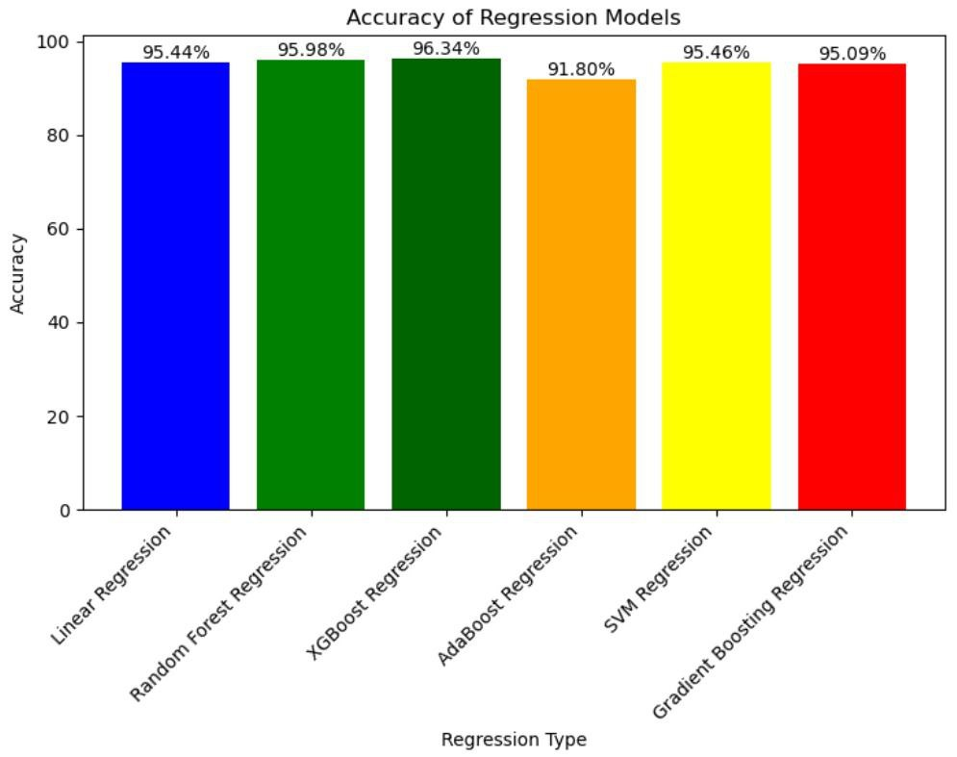

Slide 12
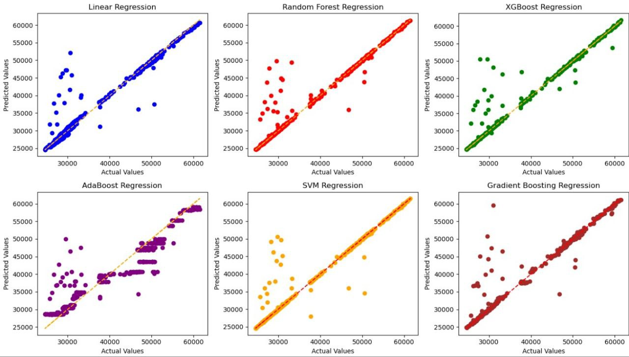

Slide 13
CONCLUSION
We meticulously constructed a comprehensive dataset encompassing historical gold prices. The project's core involved data pre-processing, feature extraction, model training, and evaluation. The project's findings hold immense value for various stakeholders within the gold market. The insights gleaned from the model analysis not only provide gold price predictions but also shed light on the key economic factors that most significantly influence price fluctuations.

Slide 14
THANK YOU

